Slide 1
The Internet
Introduction

Slide 2



Group 20
Hồng Quân
Thu Trang
Hoài Nam

Slide 3
Table of contents
1.
Learning objectives
2.
Significances
3.
Strategy
Why you should learn our topic
What you will study from our topic
How we will prepare for our presentation

Slide 4
01
Learning objectives

Slide 5

Our evolution
1
3
To acquire how computer networks came into being
2
To know basics of cybersecurity, hacking and cyber attacks
To understand the fundamental principles and techniques that power computer networks

Slide 6
02
Significances

Slide 7
1.
Computer Networks
2.
The Internet
Significanes
3.
World Wide Web
4.
Cybersecurity
5.
Hackers

Slide 8
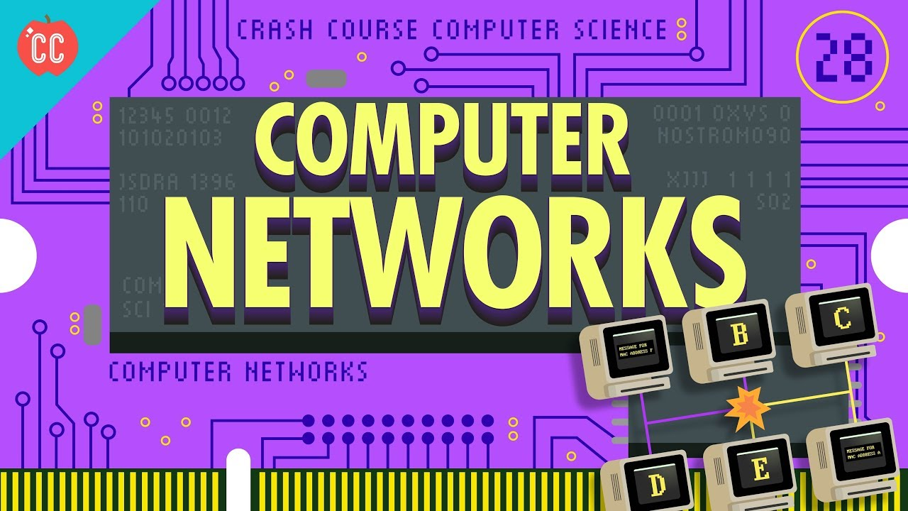

Our company
Do you know what helps you make your point crystal clear?
Lists like this one:
They’re simple
You can organize your ideas clearly
You’ll never forget to buy milk!
And the most important thing: the audience won’t miss the point of your presentation

Slide 9
Computer Networks
- How it grew from a small groups of connected computers on LAN networks to larger worldwide and Internet we know nowadays

Slide 10
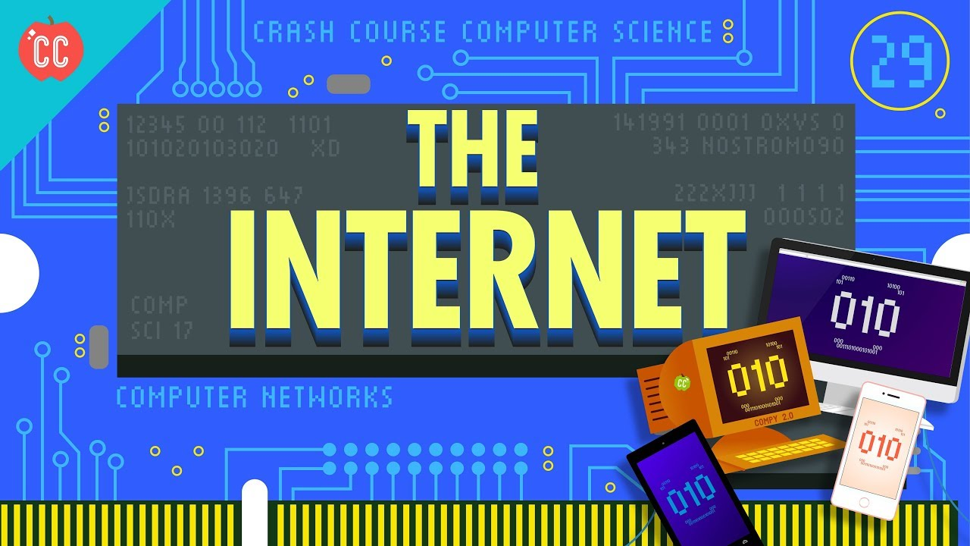

Slide 11
Internet
- How data is passed back and forth
- How a domain name is registered by the DNS
- How the data requested or sent gets to the right person

Slide 12
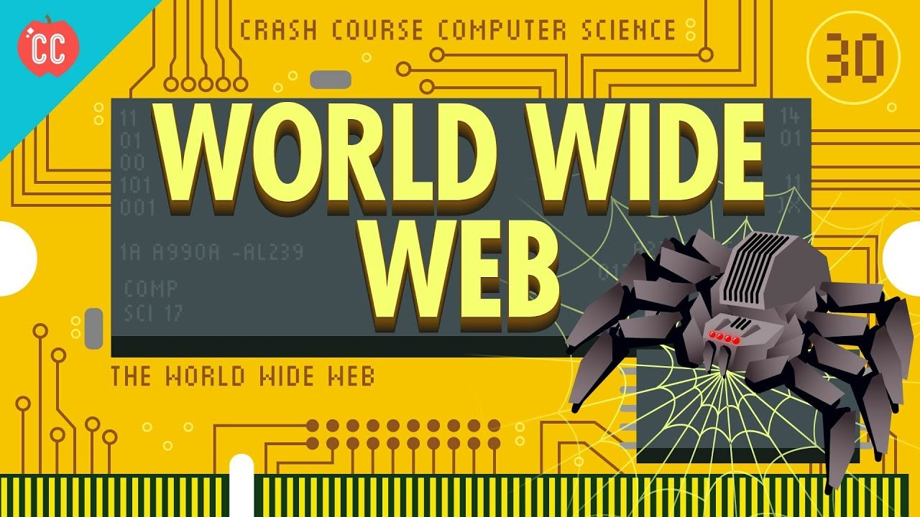

Slide 13
World Wide Web
It is built on the foundation of simply linking pages to other pages with hyperlinks
It is a system of interconnected public webpages accessible through the Internet
The downside of World Wide Web

Slide 14
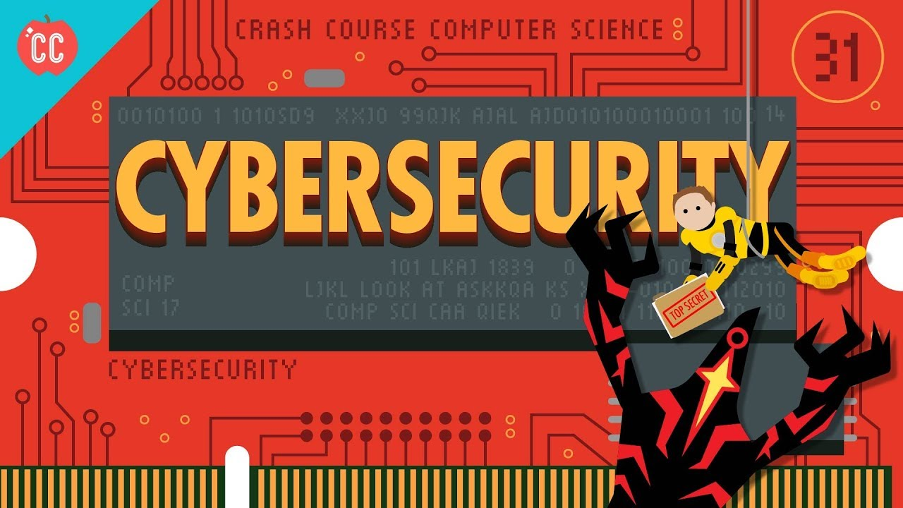

Slide 15
Cybersecurity
- It is a set of techniques to protect the secrecy, integrity, and availability of computer systems and data against threats
- Some strategies to keep our information as secure, but also as accessible as possible.

Slide 16


Slide 17
Hackers and Cyber Attacks
- The strategies hackers use to gain access to your devices, so you can be better prepared to keep your data safe.

Slide 18
03
Strategy

Slide 19


Week 1 + 2
Phan Thị Thu Trang: Computer Network
Phạm Hoài Nam: the Internet, World Wide Web
Phạm Hồng Quân: CyberSecurity and Hacker & Cyber Attacks
Setting up an exact meeting date for each week
Creating a group to discuss together

Slide 20



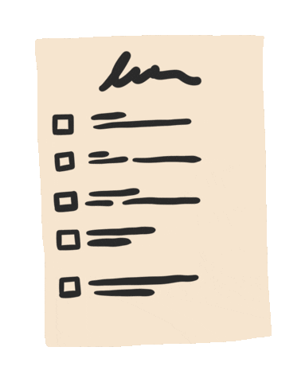
Week 3 + 4

Slide 21

Thanks for your attention!

